Slide 1
Behavioral Health Primary Care Integration
Charles C. Fenzi, MD
CEO/CMO
Santa Barbara Neighborhood Clinics

Slide 2
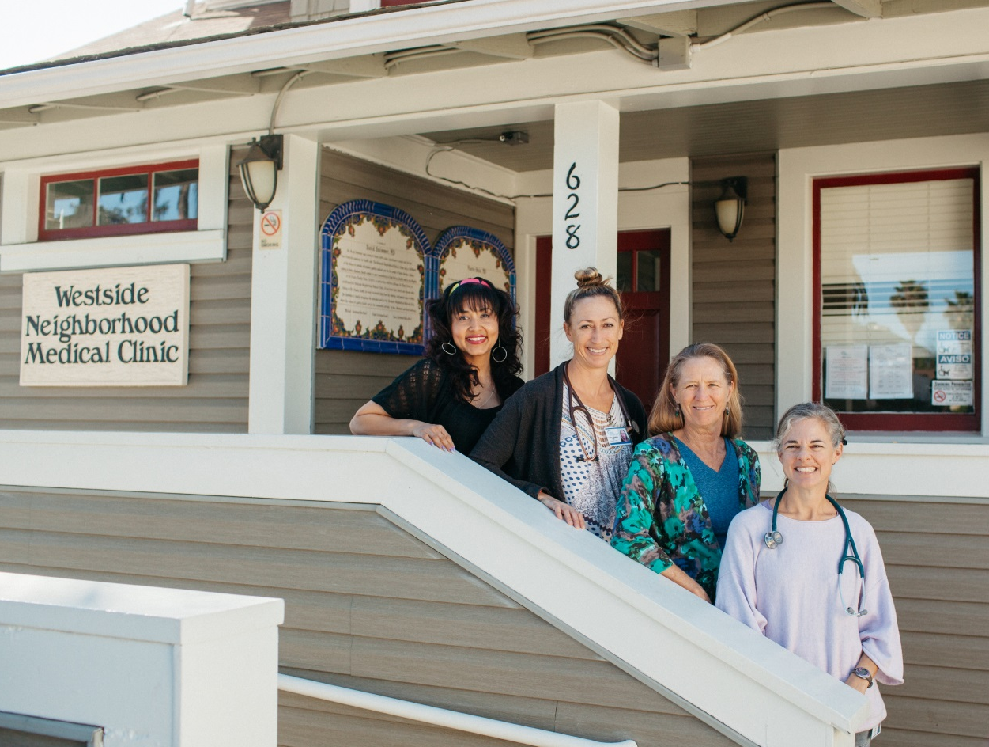
Our Talk Today
A Bit of History
First Integration
Expanding the Team
What is Integration
Collaborative Integration

Slide 3
A Bit of History

Slide 4
The Lengthy Evolution
The Early Program – 2009
William & Mary Jane Brinton
Neighborhood Counseling Program
Bilingual and bicultural
Notes:
Great-great grand daughter of John Deere, inventor of the steel plow

Slide 5
The Lengthy Evolution
Interim Program – Contractors
SBNC was not a DHCS recognized Behavioral Health Entity so patients paid out-of-pocket at a greatly discounted rate
Eduardo Guzman, MD, psychiatrist provided care one day every two weeks
Karina Valle, LCSW, made herself available weekly and went to all three medical clinics

Slide 6
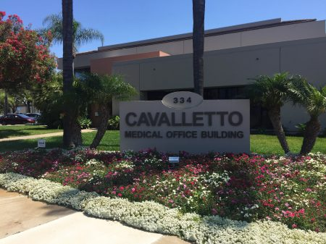
Rising from the ashes
First Integration – Temporary Goleta Clinic
In scope as a recipient of a 330e grant (FQHC)
Jennifer Ferraez, LCSW - Our first LCSW
Available to see patients in collaboration with the primary care provider
Warm hand-offs welcome
Two exam rooms and a Behavior Health Office
Same health record

Slide 7
SBNC Integration
Summer of 2016 - the organization was awarded a HRSA Substance Abuse Expansion Grant
Goal - Full integration of behavioral health with primary care, including SBIRT and MAT
Every patient over the age of 10 - screened annually for substance use disorder and major depressive disorder
Partnerships are in place with CADA and Sanctuary Centers
Three providers have DATA 2000 waivers and are actively engaged in MAT to those individuals for whom that tool is indicated.
Notes:
Those that test positive on the Drug Abuse Screening Tool (DAST) undergo a brief intervention with their provider and are referred to BH where they are offered motivational counseling. Collaborations are in place with the Counsel on Alcoholism and Drug Abuse (CADA) and Sanctuary Centers, an organization targeting individuals with coexisting disorders, to provide resources to those who have agreed to treatment. Two of the organization’s providers have obtained DATA 2000 waivers and are actively engaged in MAT to those individuals for whom that tool is indicated.

Slide 8
Level 1: Minimal Collaboration
Mental health and other healthcare providers work in separate facilities, have separate systems, and rarely communicate about cases.
Notes:
William and Mary Jane Brinton Neighborhood Counseling Program

Slide 9
Level 2: Basic Collaboration at a Distance
Providers have separate systems at separate sites, but engage in periodic communication about shared patients, mostly through telephone and electronic means. Providers view each other as resources.

Slide 10
Level 3: Basic Collaboration Onsite
Mental health and other healthcare professionals have separate systems, but share facilities. Proximity supports at least occasional face-to- face meetings and communication improves and is more regular.
Notes:
Doctor Guzman and Karina Valle

Slide 11
Level 4: Close Collaboration in a Partially Integrated System
Mental health and other healthcare providers share the same sites and have some systems in common such as scheduling or charting. There are regular face-to-face interactions among primary care and behavioral health providers, coordinated treatment plans for difficult patients, and a basic understanding of each other’s roles and cultures.
Notes:
Cavalletto Building Clinic

Slide 12
Level 5: Close Collaboration in a Fully Integrated System
Mental health and other healthcare professionals share the same sites, vision, and systems. All providers are on the same team and have developed an in-depth understanding of each other’s roles and areas of expertise.
Notes:
AIMS Collaborative Care Model

Slide 13
Collaborative Care AIMS Model
IMPACT Trial Conducted by Dr. Jürgen Unützer
Journal of the American Medical Association (JAMA)
December 11, 2002
Notes:
Half of the patients were randomly assigned to receive the care normally available in their primary care clinic, including medications (70% of usual care patients) and/or referral to specialty mental health. The other half of patients were randomly assigned to receive the IMPACT model of depression care, also known as Collaborative Care. A patient registry (CMTS) was developed for the trial that tracked and measured patient goals and clinical outcomes, and facilitated treatment adjustment if a patient was not improving as expected.

Slide 14
Principles of Collaborative Care
Patient-Centered Team Care
Primary care and behavioral health providers collaborate effectively using shared care plans that incorporate patient goals. The ability to get both physical and mental health care at a familiar location is comfortable to patients and reduces duplicate assessments. Increased patient engagement oftentimes results in a better health care experience and improved patient outcomes.

Slide 15
Principles of Collaborative Care
Population-Based Care
Care team shares a defined group of patients tracked in a registry to ensure no one falls through the cracks. Practices track and reach out to patients who are not improving and mental health specialists provide caseload-focused consultation, not just ad-hoc advice.

Slide 16
Principles of Collaborative Care
Measurement-Based Treatment to Target
Each patient’s treatment plan clearly articulates personal goals and clinical outcomes that are routinely measured by evidence-based tools like the PHQ-9 depression scale. Treatments are actively changed if patients are not improving as expected until the clinical goals are achieved. Sometimes called Stepped Care.

Slide 17
Principles of Collaborative Care
Evidence-Based Care
Patients are offered treatments with credible research evidence to support their efficacy in treating the target condition. These include a variety of evidence-based psychotherapies proven to work in primary care, such as PST, BA and CBT, and medications. Collaborative Care itself has a substantial evidence base for its effectiveness, one of the few integrated care models that does.

Slide 18
Principles of Collaborative Care
Accountable Care
Providers are accountable and reimbursed for quality of care and clinical outcomes, not just the volume of care provided.

Slide 19
Collaborative Integration
Sanctuary Centers - establish an “Integrated Care Clinic” on their campus providing medical and dental services to clients with co-existing disorders.
Intermittent clinic - opened in July, 2017 with one exam room and one dental operatory, staffed by SBNC.
Behavioral Health services provided on-site by Sanctuary Centers.
Ultimate goal - partner in a full-service integrated clinic on the ground floor of a “new” apartment building for adults with Mental Illness and Veterans on their campus with three exam rooms and three operatories.
Sanctuary Clinics will provide the behavioral health staff while SBNC supplies the medical and dental staff.
Notes:
In addition to the collaboration on substance use disorder, we are engaged with Sanctuary Centers to establish an “Integrated Care Clinic” on their campus. An intermittent clinic is scheduled to open in July with one exam room and one dental operatory. Behavioral Health services will also be provided on-site. This will be the area’s only truly “integrated” medical/dental/behavioral health clinic in the City of Santa Barbara. The ultimate goal is to partner in a full-service integrated clinic on the ground floor of a “new” apartment building for adults with Mental Illness and Veterans on their campus with three exam rooms and three operatories. In each of these clinics Sanctuary Clinics will provide the behavioral health staff while SBNC supplies the medical and dental staff.

Slide 20
Collaborative Integration
CALM - pilot project to identify families at risk for Adverse Childhood Experiences (ACEs).
Children are screened during their routine “well child” visits by their pediatrician at 4, 6 or 9 months.
Those found to be at risk will be directed toward resources through CALM designed to ameliorate the risk of trauma to the child.
Notes:
Our organization is in a collaborative pilot with Child Abuse, Listening, & Mediation (CALM) in a project to identify families at risk for Adverse Childhood Events (ACEs). Under this program, children will be screened during their routine “well child” visits by their pediatrician. Those found to be at risk will be directed toward resources designed to ameliorate the risk of trauma to the child.

Slide 21
Partnerships
Cottage Health, - SBNC is working with Cottage Hospital in establishing a “bridge” clinic providing rapid access to patients presenting with substance use disorder to the ED and trauma unit.
Staffing includes specialists in addiction medicine, psychiatry and pain management, a counselor and a behavioral health coordinator.

Slide 22
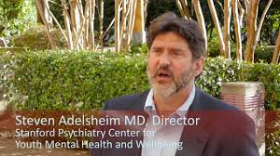
Head Space
One stop shops for youth health care which include key elements of primary care, mental health, alcohol/drug, and vocational/ educational support.

Slide 23
Santa Barbara Behavioral Health Coalition
Cottage Health
CenCal Health
Sansum Clinic
Santa Barbara Neighborhood Clinics
Santa Barbara Behavioral Wellness
Santa Barbara County Public Health Department

Slide 24
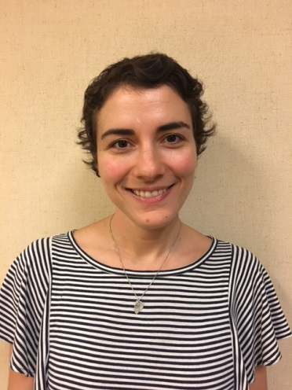
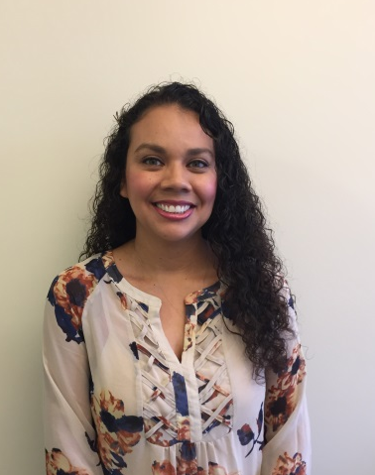
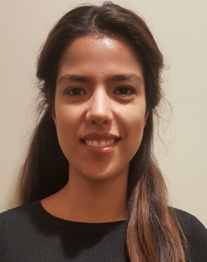
The Expanding Team
Kayla Rosen, MD
Psychiatry
Max Rorty, LCSW Isla Vista
Veronica Gaona, LCSW
Westside
Stephanie Fagliano, LCSW
Eastside
Deise Capristo, LCSW
Goleta
Elsa Buenrostro, LCSW
Bridge
Janice Shea
BH Coordinator

Slide 25
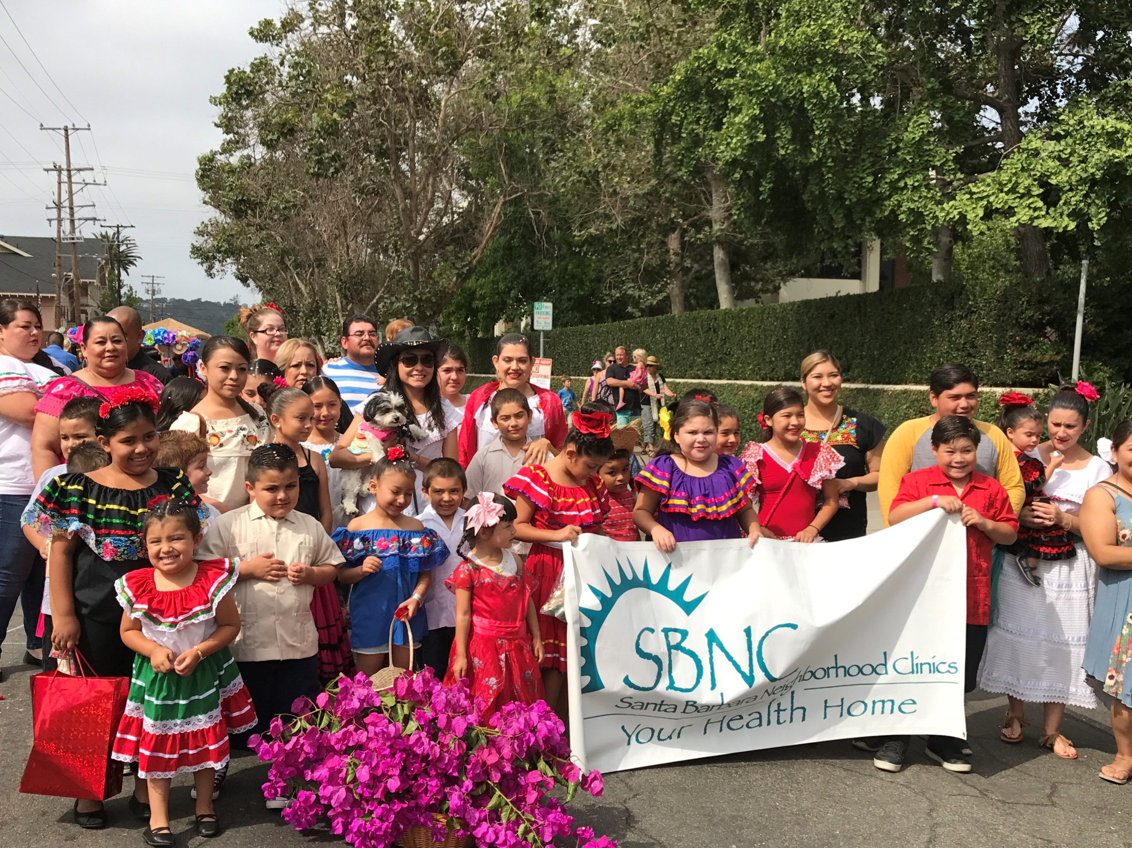
Questions

